Slide 1
Spatial Omics Analysis of Neutrophil–T Cell Interactions in Head and Neck Squamous Cell Carcinoma
Cells in Context Symposium, 9/11/2025
Evan Johns, University of Wisconsin School of Medicine and Public Health, M.D. Candidate

Slide 2
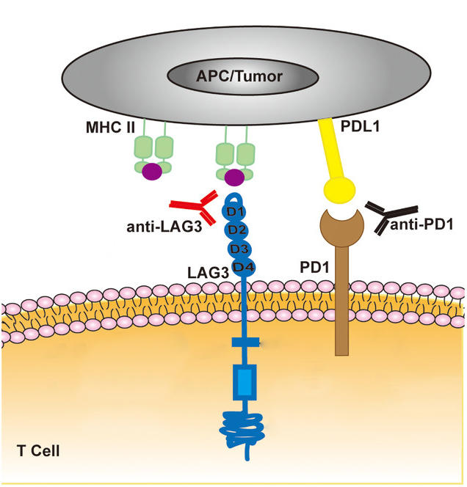
Background - Immune Checkpoint Blockers (ICBs)
Immune checkpoint proteins protect healthy cells from T-cell attacks but limit cancer response.
Immune checkpoint blockade (ICB) has transformed melanoma treatment but is less effective in other cancers (1).
Head and neck squamous cell carcinoma (HNSCC) is common and deadly, yet only ~18% of patients currently benefit from ICB (2,3).
Figure: Adapted from Clinical and Translational Medicine. March 2021. https://doi.org/10.1002/ctm2.365. CC BY 4.0.

Slide 3
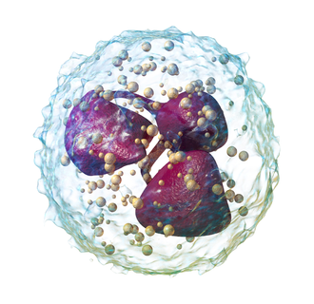
Background - Neutrophils
Neutrophils were once thought to have little flexibility due to short lifespans and low RNA.
New research show they regulate carcinoma progression with both pro- and anti-tumor roles.
In their pro-tumor state, neutrophils suppress T cells and promote angiogenesis (4).

Slide 4
Specific Aims
Research Aim: Develop a model to measure the spatial co-localization between neutrophils and different T-cell subsets in HNSCC patients treated with immunotherapy.
Hypothesis: Neutrophil interactions with T-cell subsets and tumor cells will serve as predictive factors for immunotherapy treatment response in HNSCC patients.

Slide 5
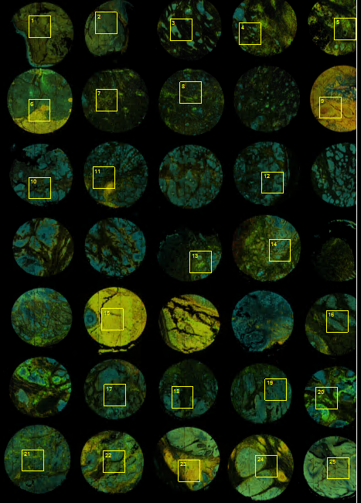
Project Data Source- Protein
CosMx Protein Assay
68 samples from 26 patients of HNSCC
64 panel protein expression
Morphology visualization: PanCK, CD45, CD3, CD298/B2M antibodies and DAPI
64-Plex CosMx Protein IO Panel
4-1BB | CD14 | CD31 | CD56
B7-H3 | CD15 | CD34 | CD68
Bcl-2 | CD16 | CD38 | CD8
Beta-catenin | CD163 | CD39 | CTLA4
CCR7 | CD19 | CD4 | EGFR
CD11b | CD20 | CD40 | EpCAM
CD11c | CD27 | CD45 | FABP4
CD127 | CD3 | CD45RA | Fibronectin
FOXP3 | IDO1 | LAMP1 | Rabbit IgG
GITR | IgD | Mouse IgG1 | SMA
GZMA | IL-18 | NF-kB p65 | STING/TMEM173
GZMB | IL-1b | p53 | Syndecan-1
HER2 | IL3RA/CD123 | pan-RAS | TCF1/TCF7
HLA-DR | iNOS | PD-1 | TIM3
ICAM1 | Ki-67 | PD-L1 | Vimentin
ICOS | LAG3 | PD-L2 | VISTA

Slide 6


Methodology – Neighborhood

Slide 7
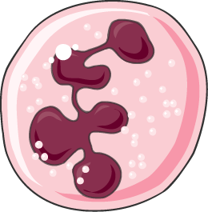
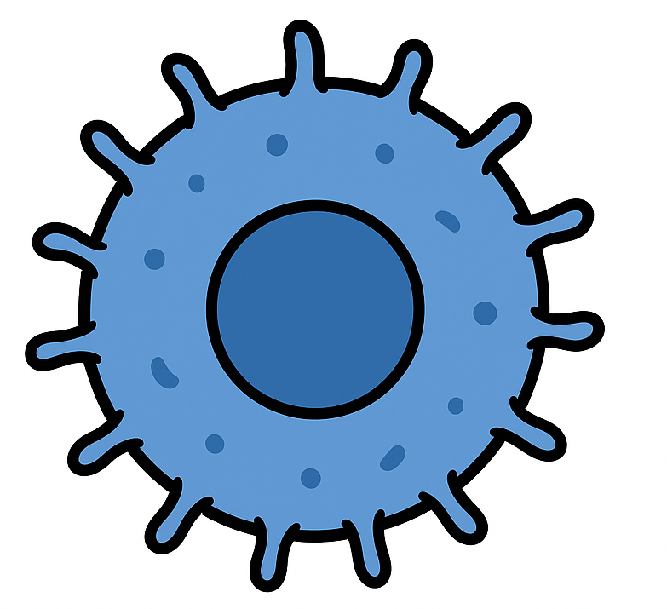

Methodology - Colocalization
Most intercellular communication requires close proximity, as methods such as direct contact, receptor–ligand binding, and soluble signals are constrained by distance (5).
Cells within 10-30 µm are considered most likely to be interacting (5).
In this analysis cells with centroids within 15 µm were considered colocalized or likely interacting.
Trends were consistent between 10-30 µm.
PMN
15 µm
CD8+ T-Cell
Tumor Cell
PMN

Slide 8
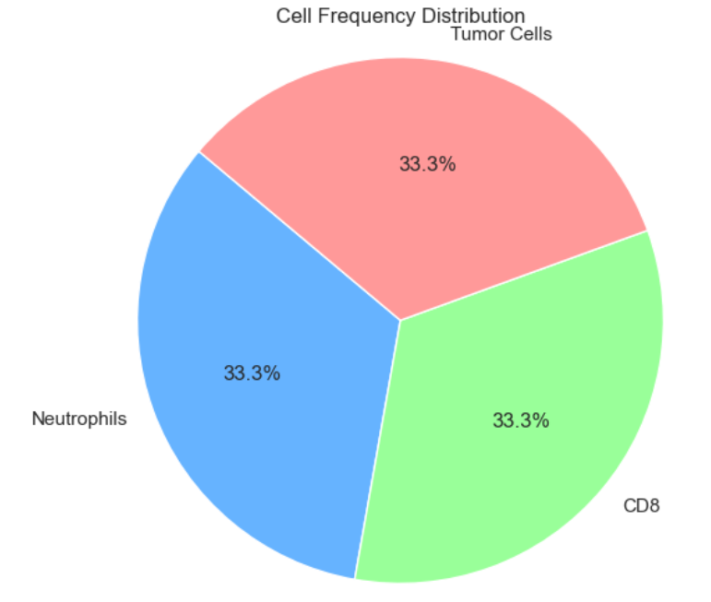
Methodology – Cellular Neighborhood
The cellular neighborhood, defined as the cells in close proximity (15 µm) to neutrophils, was quantified for each sample.
PMN
15 µm
CD8+ T-Cell
Tumor Cell
PMN

Slide 9
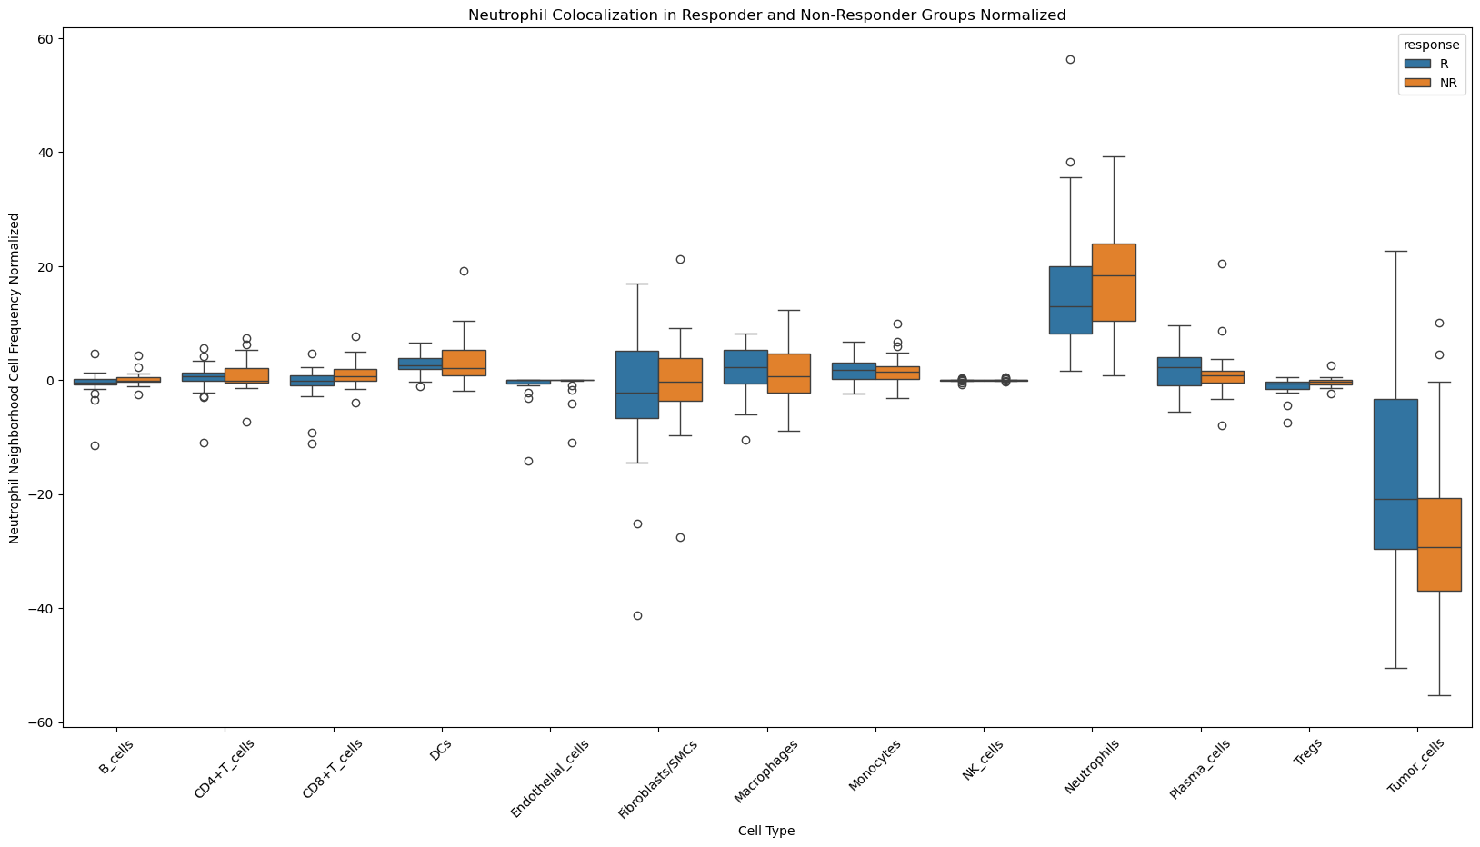
Normalized Neutrophil Interaction – All Cell Types

Slide 10
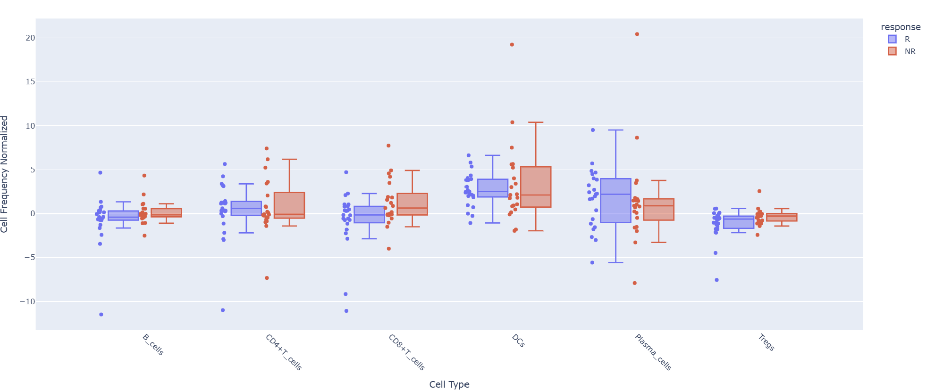
Neutrophils Interact More With CD8+ and Tregs in NRs
*
*
Takeaways
Non-responder (NR) neutrophils interact more with CD8 T-cells (p=0.036) and Tregs (p=0.006), relative to frequency.
NRs have fewer CD8 T-cells than responders (R).
No NR–R difference in neutrophil interactions with CD4 T-cells or DCs.

Slide 11
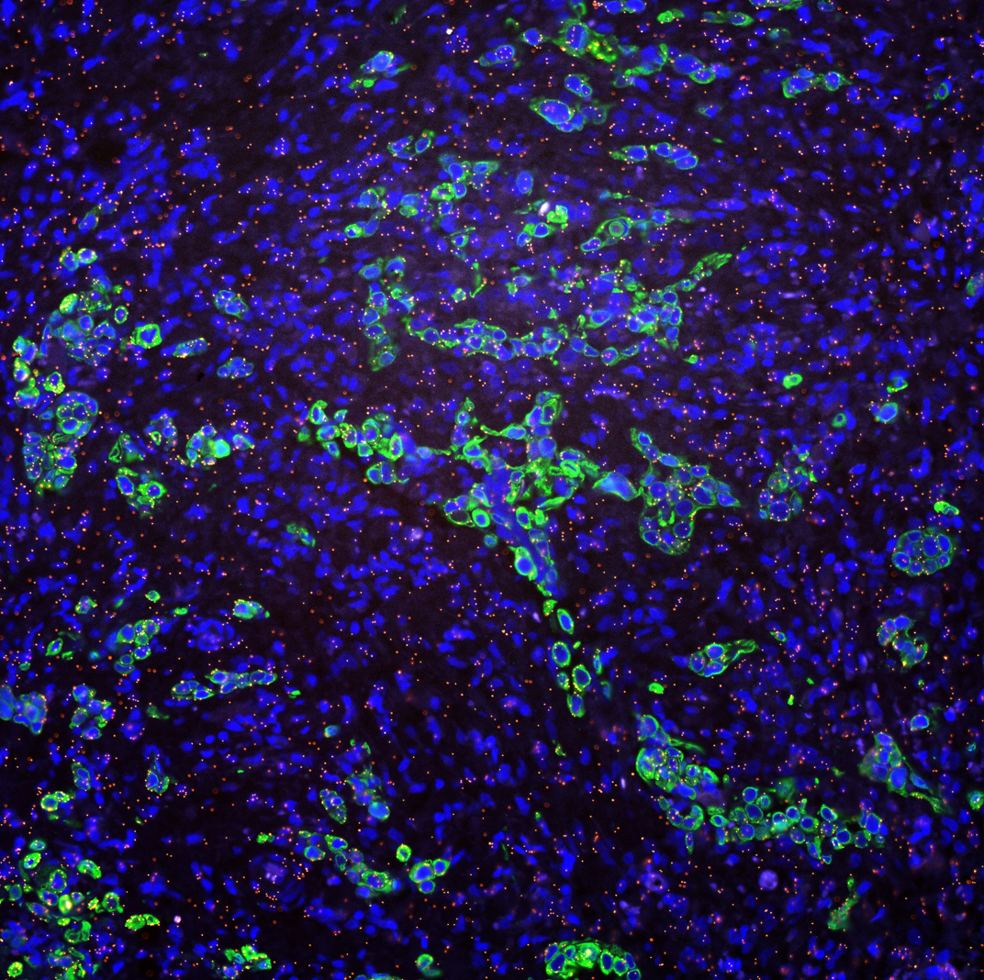
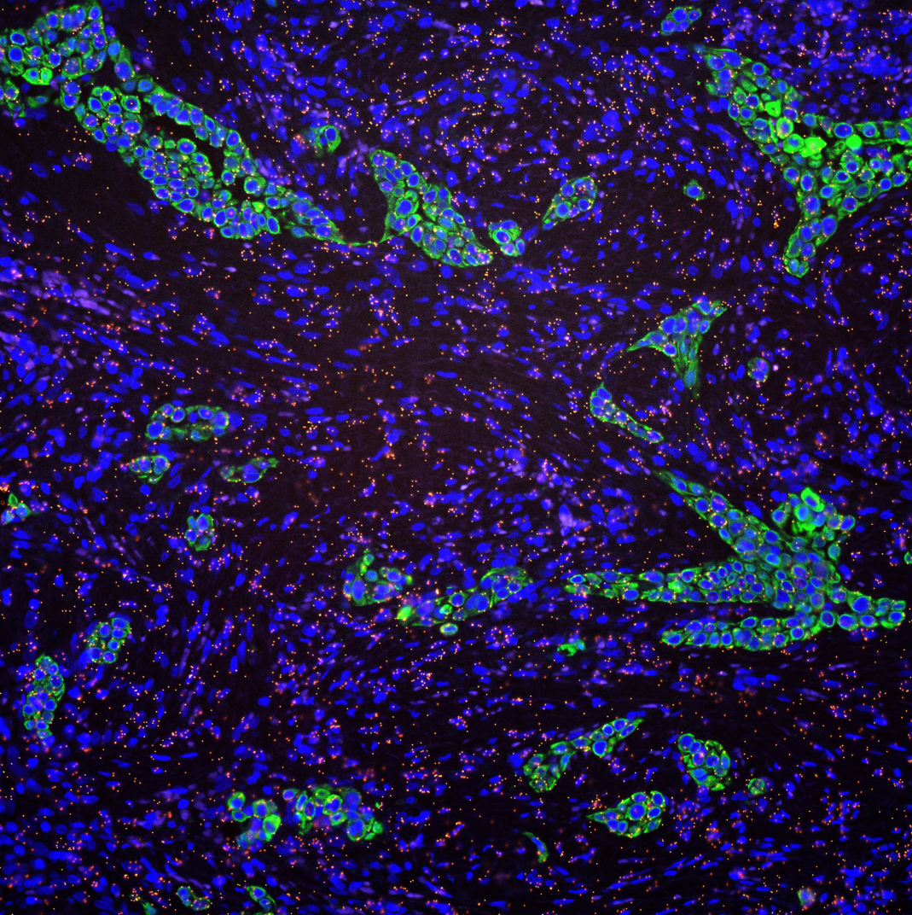
Example: Higher Nuetrophil-CD8 Interaction in NRs
Responder
Non-Responder
Cell Composition:
CD8: 5.63%, PMN: 4.004%, Tumor: 22.1%
Cell Composition:
CD8: 6.14%, PMN: 3.19%, Tumor: 18.8%

Slide 12
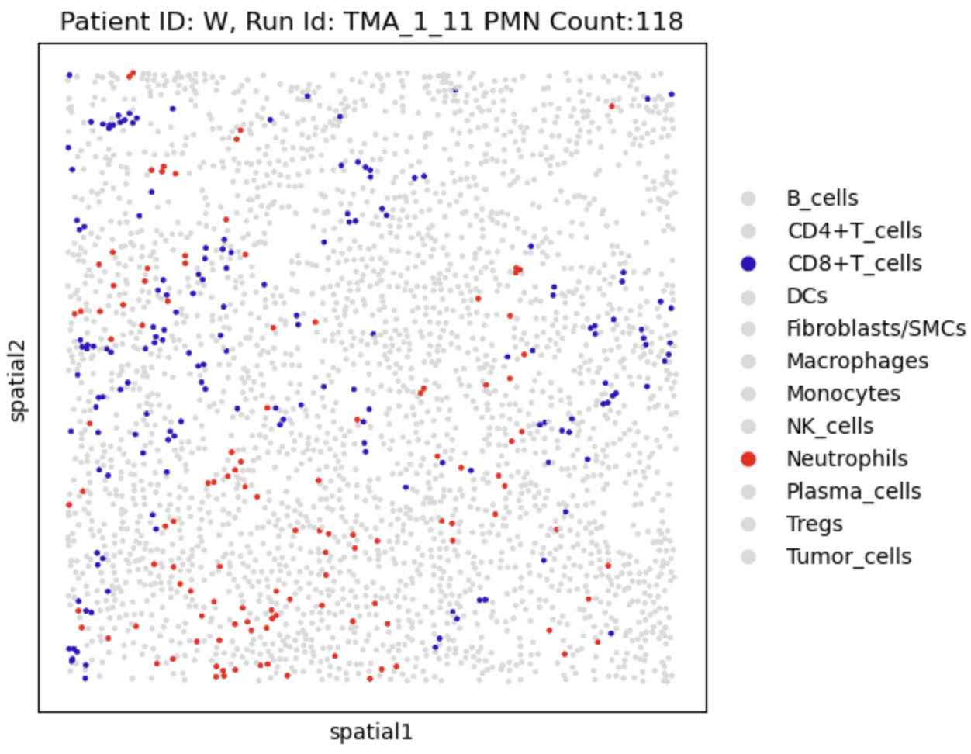
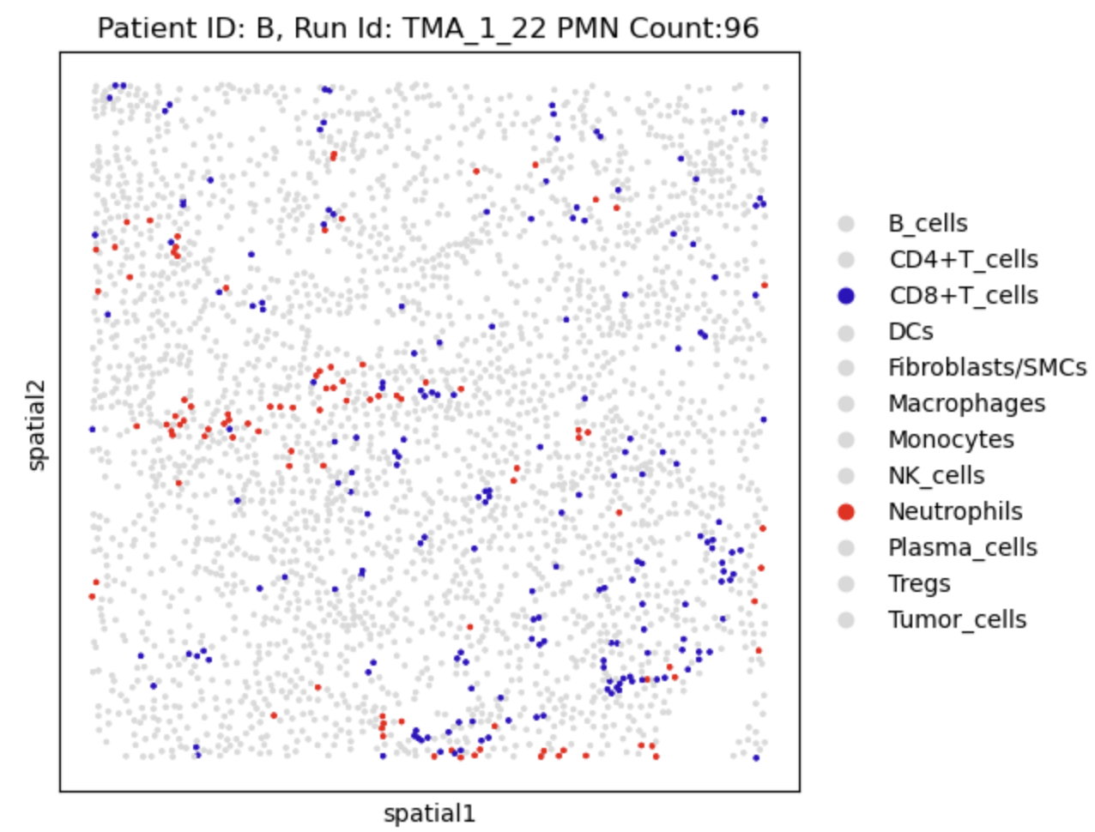
Example: Higher Nuetrophil-CD8 Interaction in NRs
Responder
Non-Responder
Nuetrophil-CD8+ Neighborhood: 2.78%
Nuetrophil-CD8+ Neighborhood: 7.017%

Slide 13
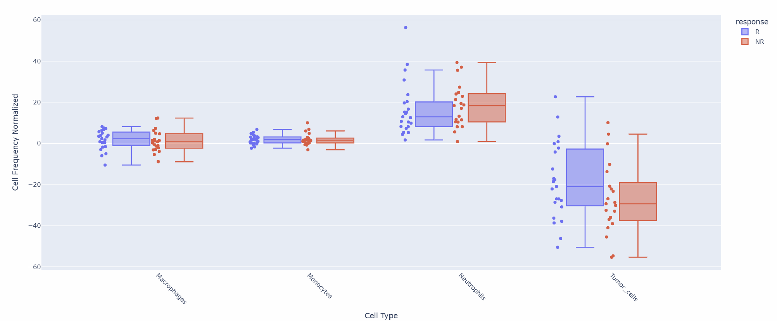
Neutrophils Interact with Tumor Cells More in Rs
Takeaways
Neutrophils cluster amongst themselves but there is no major difference between responder and non-responders.
Responders have higher neutrophil-tumor interactions (p=0.051) relative to overall frequency.

Slide 14
Conclusion & Future Directions
Neutrophil interactions with CD8 and Treg cells were more frequent in non-responders, suggesting neutrophils may limit T-cell recruitment and proliferation.
Neutrophil–tumor colocalization was more common in responders, indicating a potential antitumor role despite higher tumor burden in non-responders.
Determining the ligand–receptor pairs associated with neutrophil interactions with CD8+, Treg, and tumor cells could generate potential ICB therapy targets

Slide 15
References
Sharma P, Goswami S, Raychaudhuri D, Siddiqui BA, Singh P, Nagarajan A, Liu J, Subudhi SK, Poon C, Gant KL, Herbrich SM, Anandhan S, Islam S, Amit M, Anandappa G, Allison JP. Immune checkpoint therapy-current perspectives and future directions. Cell. 2023 Apr 13;186(8):1652-1669. doi: 10.1016/j.cell.2023.03.006. PMID: 37059068.
Hoesseini A, Sewnaik A, van den Besselaar BN, Zhang J, van Leeuwen N, Hardillo JA, Baatenburg de Jong RJ, Offerman MPJ. Prognostic model for overall survival of head and neck cancer patients in the palliative phase. BMC Palliat Care. 2024 Feb 24;23(1):54. doi: 10.1186/s12904-023-01325-y. PMID: 38395897; PMCID: PMC10893612.
Veigas, F.; Mahmoud, Y.D.; Merlo, J.; Rinflerch, A.; Rabinovich, G.A.; Girotti, M.R. Immune Checkpoints Pathways in Head and Neck Squamous Cell Carcinoma.Cancers 2021, 13, 1018. https://doi.org/10.3390/cancers13051018
Meyer MA, Dinh HQ, Alimadadi A, Araujo DJ, Chatterjee N, Gutierrez NA, Zhu YP, Hunter EL, Liang S, Seumois G, Kiosses WB, Catz SD, Vijayanand P, Ottensmeier C, Hedrick CC. Human CD79b+ neutrophils in the blood are associated with early-stage melanoma. Front Immunol. 2023;14:1224045. Doi: 10.3389/fimmu.2023.1224045. https://doi.org/10.3389/fimmu.2023.1224045
Oh J, Hoelzl J, Carlson JCT, Bill R, Peterson HM, Faquin WC, Pittet MJ, Pai SI, Weissleder R. Spatial analysis identifies DC niches as predictors of pembrolizumab therapy in head and neck squamous cell cancer. Cell Rep Med. 2025;6(5):102100. doi:10.1016/j.xcrm.2025.102100 PMID:40311615 PMCID:PMC12147904
Golfinos-Owens AE, Lozar T, Khatri P, Hu R, Harari PM, Lambert PF, Fitzpatrick MB, Dinh HQ. Integrated single-cell and spatial analysis identifies context-dependent myeloid-T cell interactions in head and neck cancer immune checkpoint blockade response. Posted March 30, 2025. Preprint. bioRxiv. doi:10.1101/2025.03.24.644582

Slide 16
Acknowledgements
Prof Huy Dinh, PhD
Dr. Athena Golfinos-Owens, PhD
Parth Khatri
Anqi Gao

